Slide 1

Lecture 8
Doubts

Slide 2
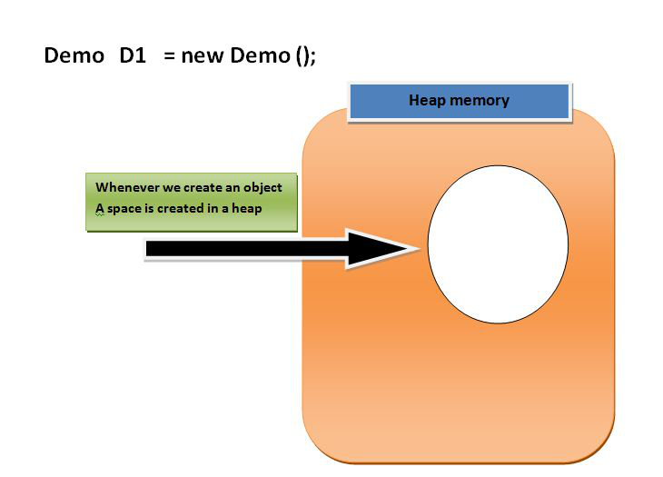
Reference Variable
Before We Started with the Reference variable we should know about the following facts.
1. When we create an object (instance) of class then space is reserved in heap memory. Let’s understand with the help of an example.an object (instance) of class then space is reserved in heap memory. Let’s understand with the help of an example.
Demo D1 = new Demo();

Slide 3
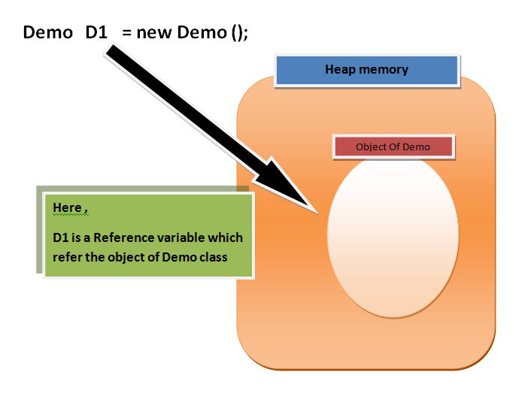

Slide 4
Understanding Reference variable
1. Reference variable is used to point object/values.
2. Classes, interfaces, arrays, enumerations, and, annotations are reference types in Java. Reference variables hold the objects/values of reference types in Java.
3. Reference variable can also store null value. By default, if no object is passed to a reference variable then it will store a null value.
4. You can access object members using a reference variable using dot syntax.

Slide 5
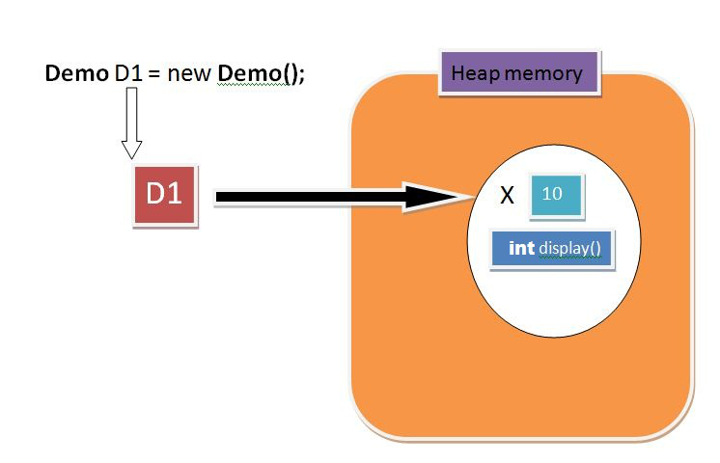
import java.io.*;
class Demo {
int x = 10;
int display()
{
System.out.println("x = " + x);
return 0;
}
}
class Main {
public static void main(String[] args)
{
// create instance
Demo D1 = new Demo();
// accessing instance(object) variable
System.out.println(D1.x);
// point 3
// accessing instance(object) method
D1.display();
}
}

Slide 6
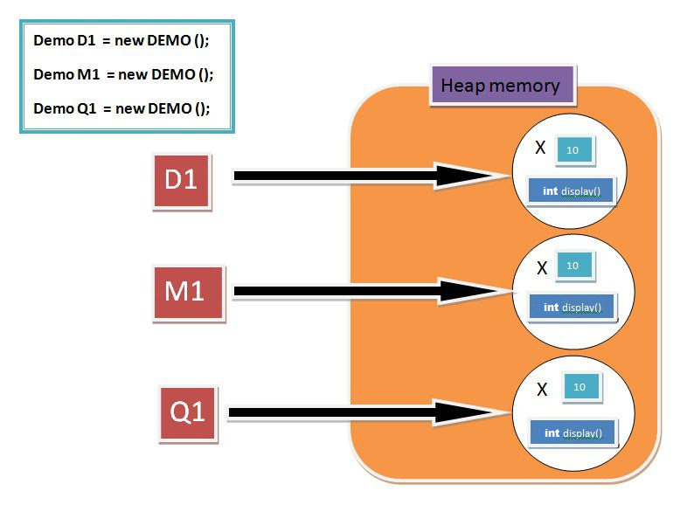
// Accessing instance methods
import java.io.*;
class Demo {
int x = 10;
int display()
{
System.out.println("x = " + x);
return 0;
}
}
class Main {
public static void main(String[] args)
{
// create instances
Demo D1 = new Demo();
Demo M1 = new Demo();
Demo Q1 = new Demo();
}
}

Slide 7
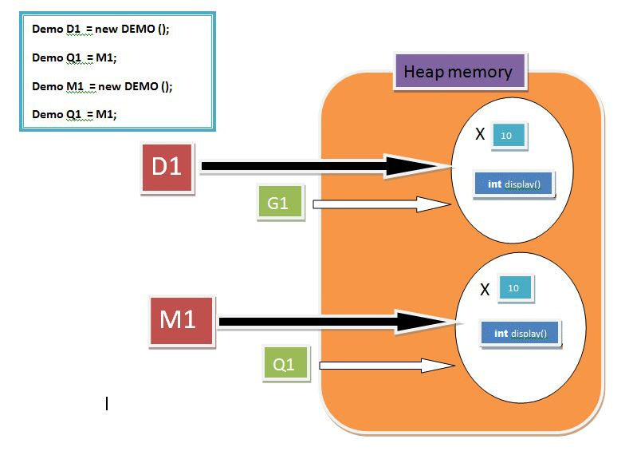
class Demo {
int x = 10;
int display()
{
System.out.println("x = " + x);
return 0;
}
}
class Main {
public static void main(String[] args)
{ Demo D1 = new Demo();
// point to same reference
Demo G1 = D1;
Demo M1 = new Demo();
Demo Q1 = M1;
// updating the value of x using G!
// reference variable
G1.x = 25;
System.out.println(G1.x); // Point 1
System.out.println(D1.x); // Point 2
}
}

Slide 8
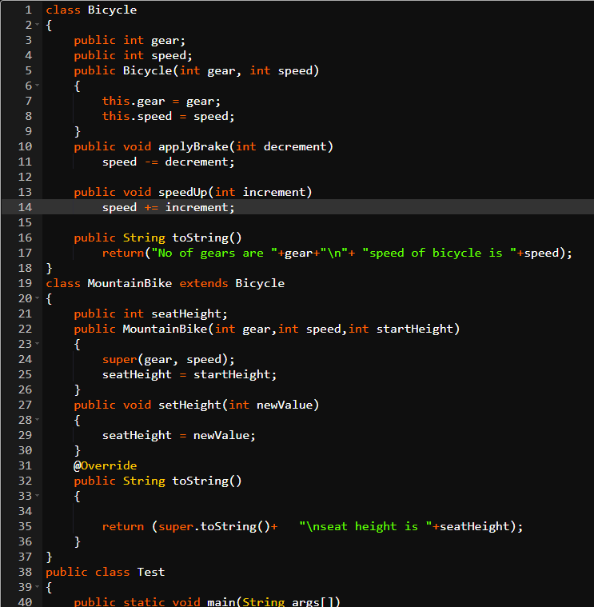
https://ide.geeksforgeeks.org/1d895d8a-fe21-41b5-b3ae-724147b2278b

Slide 9
public class Test
{
public static void main(String args[])
{
Bicycle mb2 = new MountainBike(4, 200, 20);
MountainBike mb1 = new MountainBike(3, 100, 25);
System.out.println("seat height of first bicycle is "+ mb1.seatHeight);
System.out.println(mb1.toString());
System.out.println(mb2.toString());
}
}

Slide 10
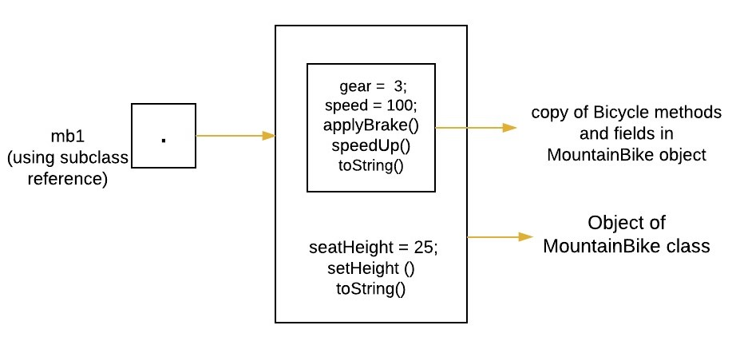
The object of MountainBike class is created which is referred by using subclass reference ‘mb1’. Using this reference we will have access both parts(methods and variables) of the object defined by the superclass or subclass. See below image for clear understanding.
MountainBike mb1 = new MountainBike(3, 100, 25);

Slide 11
Now we again create object of MountainBike class but this time it is referred by using superclass Bicycle reference ‘mb2’. Using this reference we will have access only to those parts(methods and variables) of the object defined by the superclass.
Bicycle mb2 = new MountainBike(4, 200, 20);

